Slide 1
Coastal Futures: Building Capacity for Data-driven Adaptation in Rural Coastal Communities
Social and Decision Analytics Division (UVA-SDAD)
Data Science for the Public Good Internship: (UVA- DSPG)
Josh Goldstein, Jillian Eberhart, Kishorekarthick

Slide 2
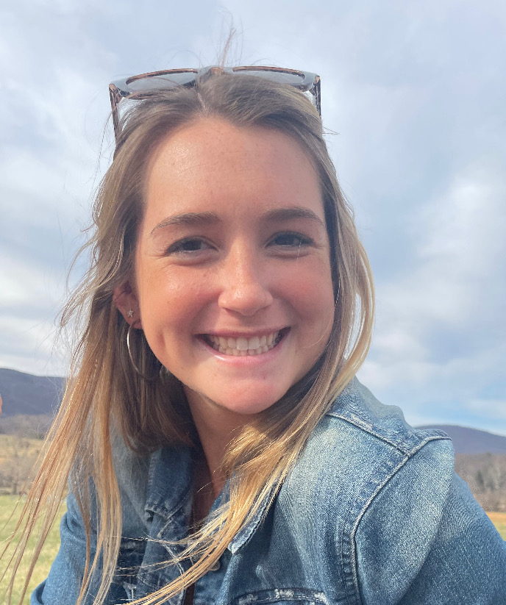

INTRODUCTION
Kishorekarthick
Major: Computer Engineering
Jillian Eberhart
Major: Statistics
Minor: Health and Wellness
Undergraduate

Slide 3
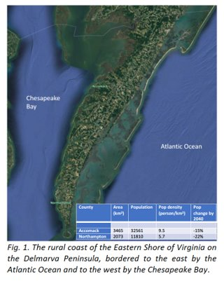
RESEARCH QUESTIONS
How do coastal flooding and groundwater salinization impact crop production and coastal habitats?
Where are climate risks and inequities most pronounced now and in the future?
How will water security change across different communities? How does this change under different adaptation policies?
Notes:
JILL-
Rural coastal communities face difficult challenges responding to climate risks, particularly by saltwater intrustion frorm accelerated sea level rise and storm flooding. This work is part of a collaboration with UVA’s Environmental Resilience Institute. The goal is to develop tools and building the capacity for communities to deal with these impacts. We will develpop a synthetic population that represents these communities by combining information across multiple sources of data, administrative and survey data, to get a representation of these rural communities down to the level of individual households and farms. This will be used as an input into agent based models for stakeholder decisions, and hydrological models to measure flood hazard, water supply, and groundwater salinization.
Sponsor national science foundation
The Coastal Futures proposal wants to address inequity and information gap for rural coasts by bringing together scholars and stakeholders to co-produce an open-source data, model, and visualization platform to spark a continuous collaboration in order to support equitable decision making and solutions on risks of flooding and saltwater intrusion.
basically information sharing
Stakeholders: individual households, Accomack and Northampton counties, conservation and community-based organizations, second home and recreation-based communities, and agriculture and poultry industries

Slide 4

GOALS
BROADER
Develop tools and building the capacity for communities to deal with the impacts of climate risk
Saltwater intrusion, accelerated sea level rise, storm flooding
Create an agent-based model to inform stakeholders' decisions
Create hydrological models to measure flood hazards, water supply, and ground water salinization
SPECIFICALLY
Create a synthetic Population using IPF (iterative proportional fitting)
Data discovery and cleaning down to the level of individual household/farm
Apply methods for demographic projections to predict how these populations will change over the next decades
This Photo by Unknown author is licensed under CC BY-NC-ND.
Notes:
JILL-
Combine environmental issues with socioeconomic issues
All the pieces we are working on is to contribute to an agent based model that brings all these aspects together into one cohesive system

Slide 5
METHODS
Geospatial Analysis : sf
Representation of objects in the real world with emphasis on the spatial geometry using sf package in R
Synthetic Population Construction : Iterative proportional fitting
Operation of finding the fitted matrix X which is closest to an initial matrix Z but with the row and column totals of a target matrix Y
Construction of Synthetic population for Accomack and Northampton counties
Demographic Projections : Co-Hort Component Method
Using the components of demographic change to project population growth and predict how these populations will change over several decades
Notes:
KISHORE'S SLIDE

Slide 6
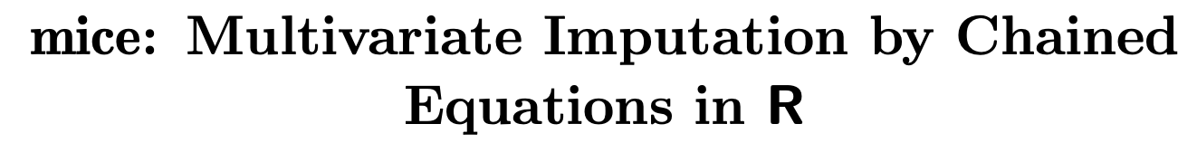

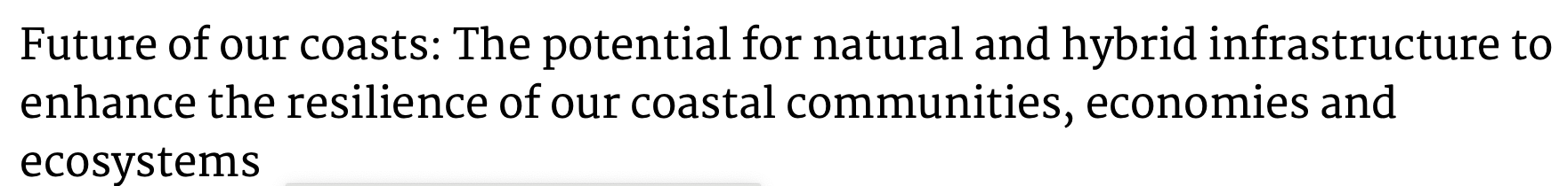

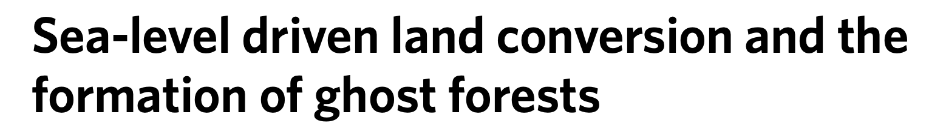
LITERATURE REVIEW
Notes:
Kishore- Climate risks : Evaluating the economic cost of coastal flooding, Future of our coasts, Racial Coastal formation, Sea level driven land conversion and the formation of ghost forests, The invisible flood etc.
Synthetic methods : Creating synthetic baseline population, Multivariate imputations by chained equations in R, Inference for partially synthetic, Public Use Microdata Sets

Slide 7
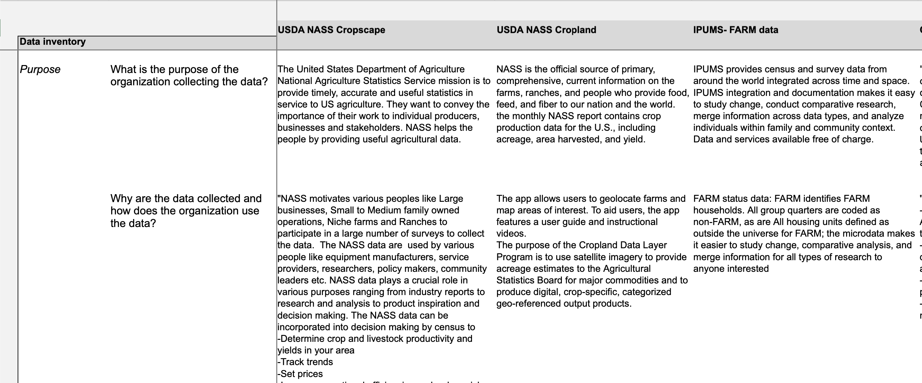
DATA INVENTORY
Explored and assessed the usability, accuracy, and biases of possible data sources at the national and state level to create this sub-county level data set that could be worked with to create a synthetic population and demographic projections
Purpose, Method, Description, Timeliness, Selectivity, Accessibility, Metadata, Stability/coherence, Accuracy, Privacy and security, research
Data sources used:
USDA NASS Cropland Data Layer (CDL)
Census of Agriculture
American Census Survey
Black Knight
ArcGIS
Notes:
Purpose: Why are the data collected and how does the organization use the data
Method: What type of data is collected? What is the data collection method?
Description: What is the nature of the data? Time series, longitudinal, one time point?, Is the data geospatial? What is the topic of the data?
Timeliness: Is the collected data available periodically?
Selectivity: What is the data universe and at what unit is represented? Does the actually universe match the stated intentions? What has been included and excluded? Why? What is the coverage?
Accessibility: How can the data be accessed? Is there a cost?
Metadata: Are there unique IDs for unique elements that can be used to link data? Are there descriptions of each variable?
Stability/coherence: Where there changes in the data capture method and if so what were they? Were there any changes in the data sources?
Accuracy: Is there any known source of error or quality control checks?
Privacy and Security: Are there legal limitations or restrictions on the use of the data? What confidentially policies are in place?
Research: What research has been done with this dataset?

Slide 8
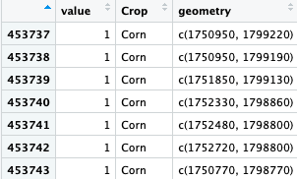
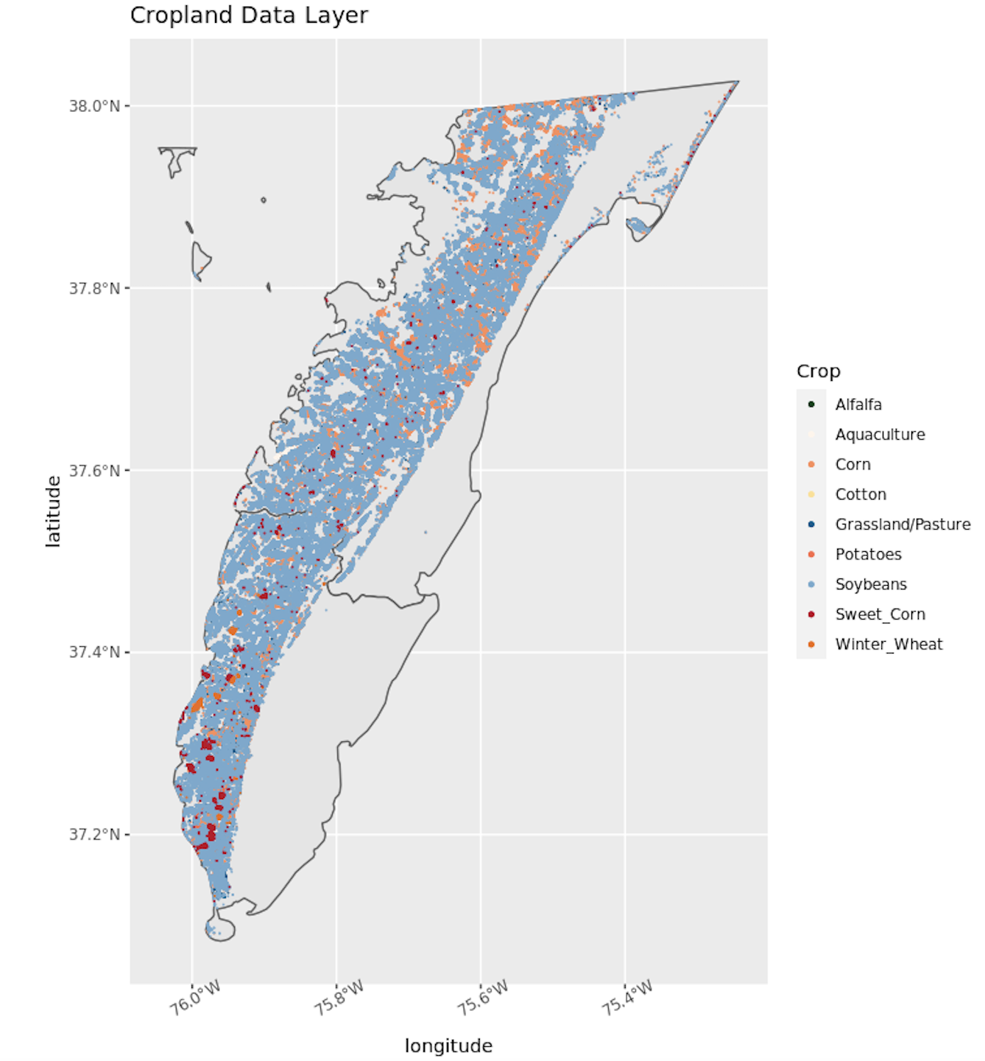
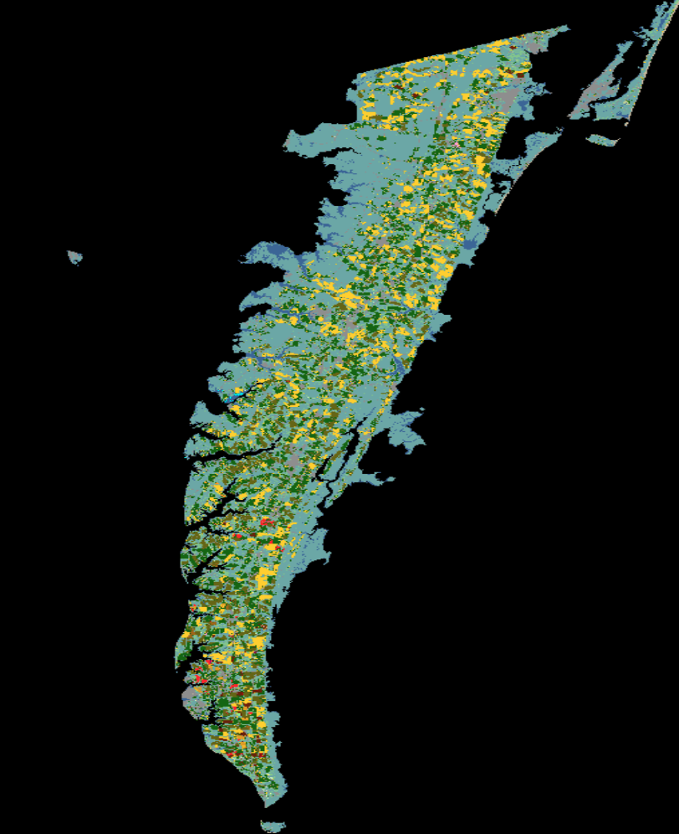
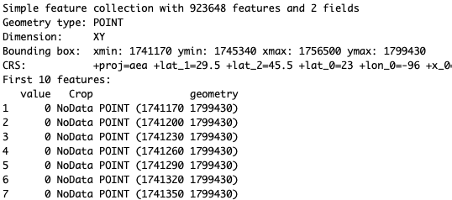
VISUALIZATIONS
Challenge: making the Cropland Data Layer into a simple features object that can be cleaned and linked to other data
Solution: the package 'CropScapeR'
Notes:
Jill-
The original website had trouble exporting the specific county data. It was imported into R as a raster image. This could not be linked to other geometries or a quantitative data set. This was not useful to our objective to link various data sources together to create a synthetic population in times series at the household level. After much trial and error and exploration of sources, we discovered two packages in R called 'tidyUSDA' and 'CropScapeR'. 'TidyUSDA' work very similar to importing ACS information in R and it allows access to well formatted USDA dataset including, but not limited to agricultural production and sales. The 'CropScapeR" package allowed the CDL data to be imported in R as a simple features object, rather than a raster. This allowed us to have a workable data set with crop cover information DOWN TO THE XXXX LEVEL with specified geometries that could be plotted and linked to numerous other sources.
Raster images are compiled using pixels, or tiny dots, containing unique color and tonal information that come together to create the image. Since raster images are pixel based, they are resolution dependent

Slide 9
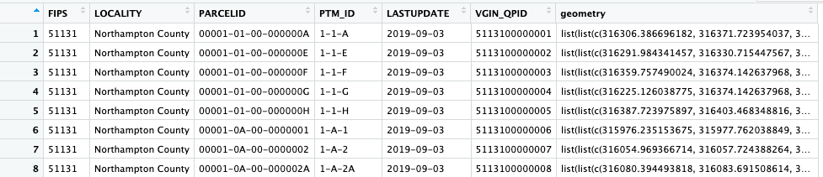
PARCELS
Notes:
Jill-

Slide 10
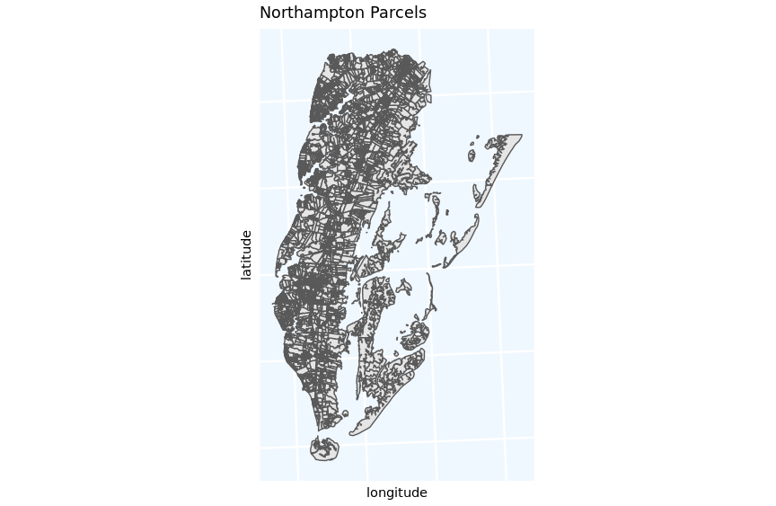
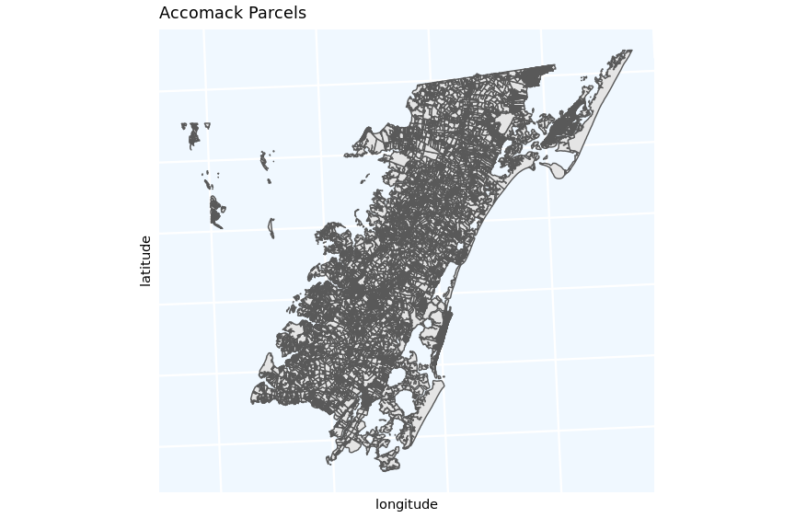
PARCELS
Notes:
Jill-

Slide 11
NEXT STEPS
Link land parcels to the Cropland Data layer (CDL):
Take the coordinates from 1 year and 1 type of crop and intersect those with the coordinates for the land parcel data to find the percent of area covered for that specific crop in the parcels
Repeat this for each crop and each year (2002-2021) to create a time series
Link all data together to create a complete data set and develop a synthetic population that represents these coastal communities
Used as an input into agent-based models for broader goals
Create demographic projections to predict how these populations will change over the next decades
Notes:
KISHORE and JIll-

Slide 12
Thank You!
Notes:
KISHORE and JIll-

